Slide 1
Digital Marketing

Slide 2
Introduction to SEO
Intent
How to Access SMERush Tool?

Slide 3
Intent
Keyword Intent
C -> Commerical Keywords - buying/purchase intent, e.g., smartphone prices
T -> Transcational Keywords - more buying intent, e.g., buy smartphone, hire accountant
I -> Informational Keywords - information intent, e.g., how to hire accountant, how to speed up your smartphones, etc
N -> Navigational keywords -> competatiors keywords -> e.g., daraz smartphones -> never target these keywords
Keyword Selection Criteria
Search Volumne -> more than 300
Keyword Difficulty / Competition -> less than 35
Intent : a.) Ecommerce/Service/Real Estate/Portfolio/Company -> Commercial
b.) Blogging -> Informational

Slide 4
How to Access SMERush Tool?
Keyword Intent
Group buy SEO Tools
Digitavision
Azadseotool
Keyword Selection Criteria
Search Volumne -> more than 300
Keyword Difficulty / Competition -> less than 35
Intent : a.) Ecommerce/Service/Real Estate/Portfolio/Company -> Commercial
b.) Blogging -> Informational

Slide 5
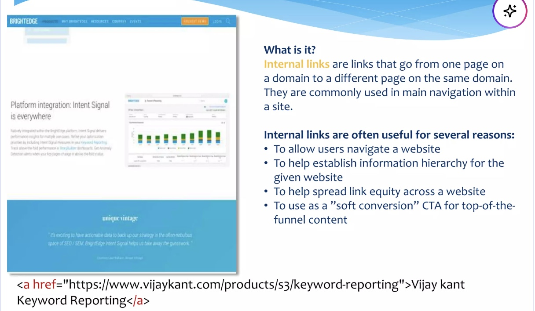
Content - Internal Links

Slide 6
Talking about SEO
SEMRush Tool
SEMRush tool -> Keyword Overview -> Enter Keywords
Pick Target Region
Click on “Search”
Class Activity : Think of your brand and generate keywords using gpt and check its score and pick the kewyords
Keyword Selection Criteria
Volume -> montlhy search volume -> higher the search volumne, more the traffic
KD (Keyword Difficulty) -> It means that how much it is difficult to rank on some keyword, higher the KB more difficult to rank means it has more competition in the market
KD : 0 - 20 : very easy to rank, ifs its between 20 - 35: easy to rank, if its between 35: - 45: hard to rank, and if its between 45: - 60: very hard to rank,
Explore keyword magic tool

Slide 7
End of Lecture

